Slide 1
Universities database project
Developed by Konstantin Savkin, an 11th-grade student of Lyceum No. 393. https://github.com/ksavkin/universities_db_project

Slide 2
Project objective
The objective of this project is to create a normalized database containing a minimum of 3 tables. Additionally, the student is required to formulate 10 unique (differing in structure) meaningful queries and master various tools for working with databases.

Slide 3
Project description
The 'Universities' database consists of 8 tables, encompassing essential criteria that prospective students consider when choosing universities. These criteria include factors like country, state, city, cost, QS rating, student reviews, admission requirements, and more.
The abundance of tables, along with different types of relationships between them, facilitates the practice of SQL queries at various levels of complexity. This structure allows for comprehensive training in database management and querying skills.

Slide 4
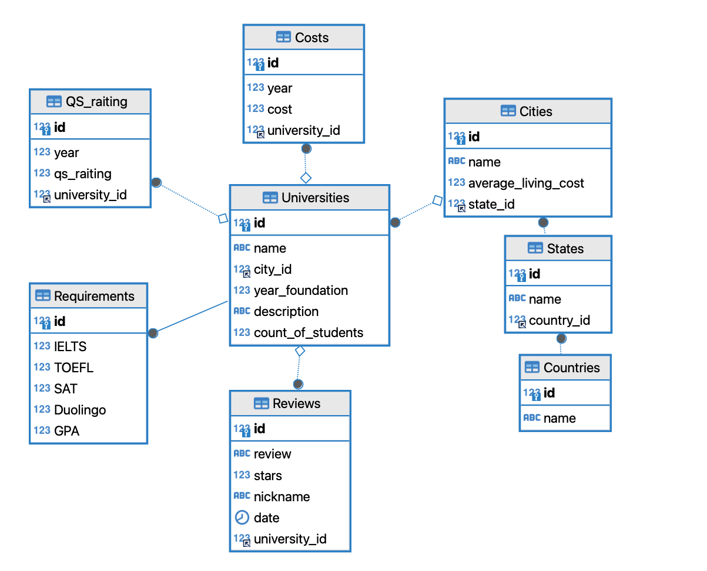
Database diagram
Link: https://dbdiagram.io/d/Universities-DB-6547a1137d8bbd6465841d33

Slide 5
Filling the database using transactions
start transaction;
INSERT INTO cities
(id, name, average_living_cost, state_id)
VALUES (31, 'Kansas City', 2900, 1),
(32, 'Atlanta', 3300, 32),
(1, 'Omaha', 2700, 33);
-- delete from cities where id=31;
-- commit;
rollback;

Slide 6
Search filter queries for a website
select c.id, c.name
from Countries c
where c.name like 'U%'
order by c.name
select s.id, s.name
from States s
where s.country_id = 1 and s.name like 'C%'
order by s.name
select id, name
from Cities
where state_id = 1
order by name

Slide 7
Displaying 2 pages of universities and reviews
select un.*, c.name, s.name, ctr.name
from Universities un
join Cities c on un.city_id = c.id
join States s on c.state_id =s.id
left join Countries ctr on s.country_id = ctr.id
order by un.name
limit 10
offset 10
select r.*
from Reviews r
where r.university_id = 11
order by r.date desc
limit 10
offset 10

Slide 8
Universities with student enrollment between 20000 and 60000
select un.id, un.name, un.count_of_students
from Universities un
where count_of_students between 20000 and 60000
order by un.count_of_students desc

Slide 9
Universities that require an IELTS score <= 7.5 (2 versions)
select un.*, rq.ielts
from Universities un
join Requirements rq on un.id = rq.id
where IELTS <= 7.5
order by rq.IELTS desc
select un.*, rq.ielts
from Universities un
join Requirements rq on un.id = rq.id and IELTS <= 7.5
order by rq.IELTS desc

Slide 10
Universities with country and ranking listed in 2021
select un.id, un.name, un.year_foundation, un.description,
c.name as city,
s.name as state,
qs.qs_raiting as raiting
from Universities un
join Cities c on un.id = c.id
join States s on c.id = s.id
join QS_raiting qs on un.id = qs.university_id where year = 2021

Slide 11
Universities with a review count >= 3
with c1 as (select un.id as id, un.name, count(*) as counter_of_reviews
from Universities un
join Reviews rev on un.id = rev.university_id
group by un.id, un.name)
select un.id, un.name, un.year_foundation, c1.counter_of_reviews
from Universities un
join c1 on un.id = c1.id
where c1.counter_of_reviews >= 3
order by c1.counter_of_reviews desc

Slide 12
Comprehensive information on universities ranked in the top 10 for 2023
select un.*, c.name as city, s.name as state, c2.name as country, qs.qs_raiting as raiting
from Universities un
join Cities c on un.id = c.id
join States s on c.id = s.id
join Countries c2 on c2.id = s.id
join QS_raiting qs on un.id = qs.university_id and qs.year = '2023'
order by qs.qs_raiting desc
limit 10

Slide 13
Universities with price change over all time not exceeding $10k and review count > 2
with
dif as
(select un.id as id3, un.name, (max(cs.cost) - min(cs.cost)) as diff from Universities un join Costs cs on un.id = cs.university_id group by un.id, un.name),
countik as
(select un.id as id4, un.name, count(*) as counter from Universities un join reviews rv on un.id = rv.university_id group by un.id, un.name)
select un.id, un.name, un.year_foundation, un.count_of_students, un.description, c.name as City, s.name State, coun.name as Country, dif.diff as difference,
countik.counter as counter
from Universities un
join Cities c on un.id=c.id
join States s on c.id = s.id
left join Countries coun on s.id = coun.id
join dif on un.id = dif.id3
join countik on un.id=countik.id4
where countik.counter > 2 and dif.diff < 10000;

Slide 14
Changes in university tuition over the years
with pr_year as (
select un.id, un.name, cs.year, cs.cost, lag(cost) over(partition by un.id order by year) as previous_year_cost
from universities un
join costs cs on un.id = cs.university_id)
select *, CONCAT(round(cost / if(previous_year_cost = 0, NULL, previous_year_cost)* 100, 2), '%')
as difference_of_cost
from pr_year

Slide 15


Main tools used in project development
dbdiagram: A tool for visual database schema design. It allows creating and editing diagrams for a clearer representation of data structure.
DBeaver: A versatile platform for database administration. It provides a wide range of features for working with various types of databases and executing SQL queries.

Slide 16
Conclusion
As a result of implementing the project, I acquired skills such as table joining, transaction usage, grouping with filters, CTE, and window functions.
I elevated my problem-solving skills in the database section of the LeetCode website.
The time spent on writing queries significantly decreased. Additionally, learning the DBeaver tool expanded my toolkit for working with databases, providing a more convenient and efficient interaction.
Collectively, these experiences have greatly enriched my expertise in the field of databases and SQL.

